Slide 1


Snap to SQL: Image to Schema Converter
Transform your ER diagrams into SQL schemas automatically using the power of AI and ML.

Slide 2

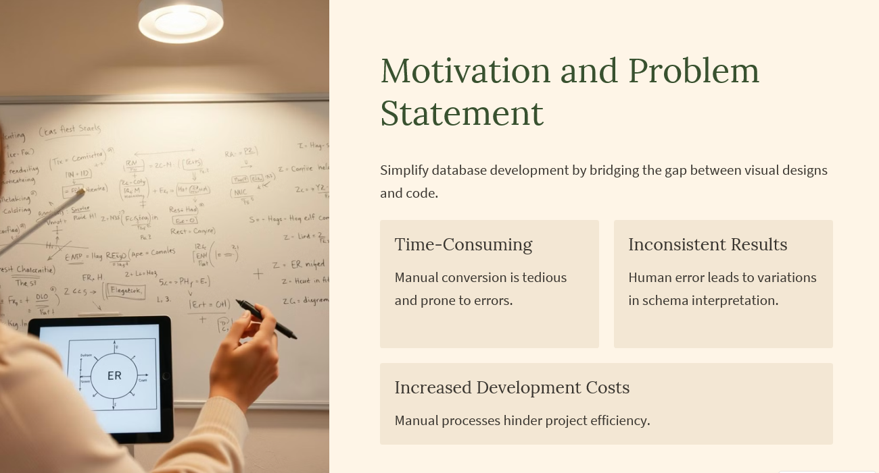
Motivation and Problem Statement
Simplify database development by bridging the gap between visual designs and code.
Time-Consuming
Inconsistent Results
Manual conversion is tedious and prone to errors.
Human error leads to variations in schema interpretation.
Increased Development Costs
Manual processes hinder project efficiency.

Slide 3
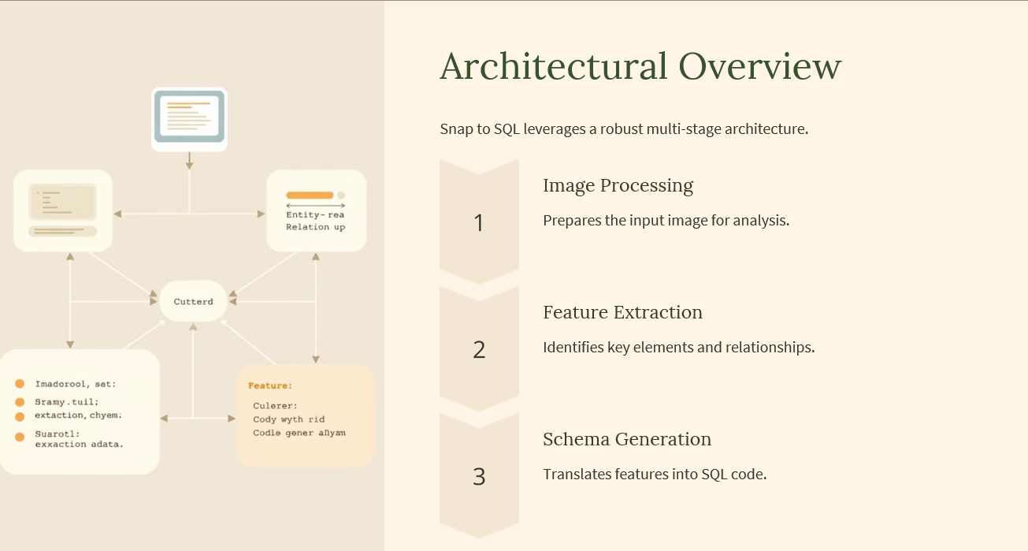
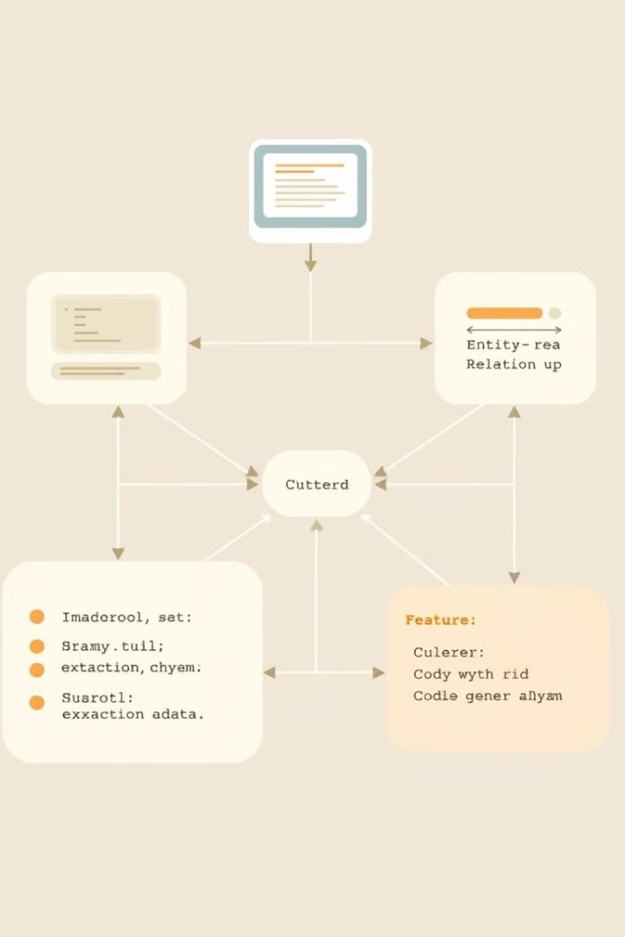



Architectural Overview
Snap to SQL leverages a robust multi-stage architecture.
Image Processing
Prepares the input image for analysis.
Feature Extraction
Identifies key elements and relationships.
Schema Generation
Translates features into SQL code.

Slide 4
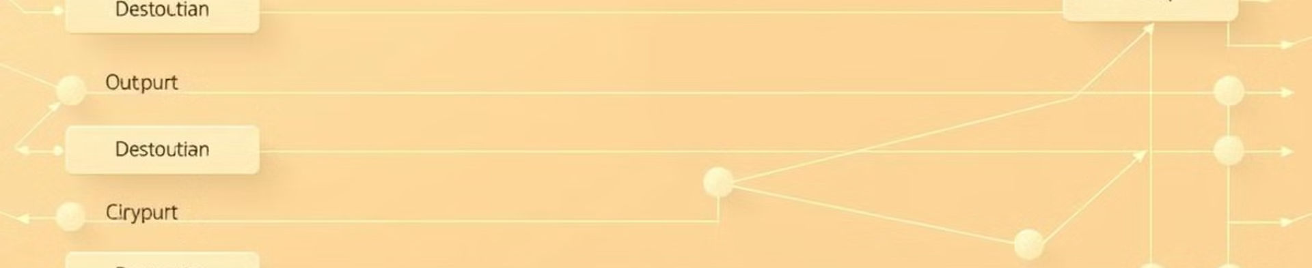
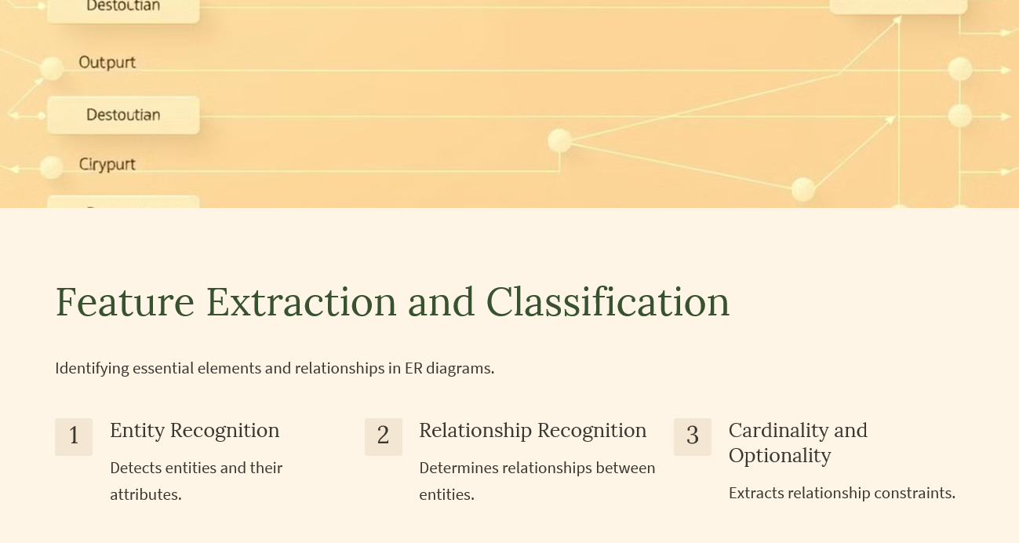
Feature Extraction and Classification
Identifying essential elements and relationships in ER diagrams.
1
Entity Recognition
2
Relationship Recognition
3
Cardinality and Optionality
Detects entities and their attributes.
Determines relationships between entities.
Extracts relationship constraints.

Slide 5
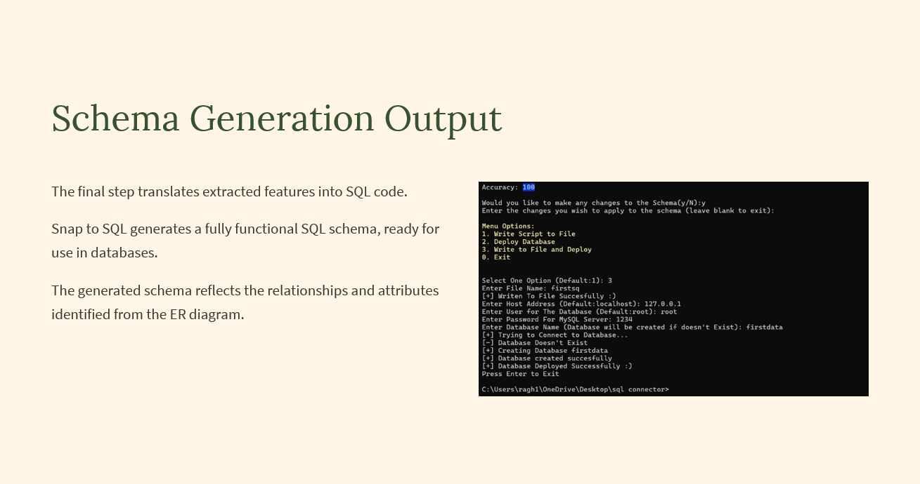
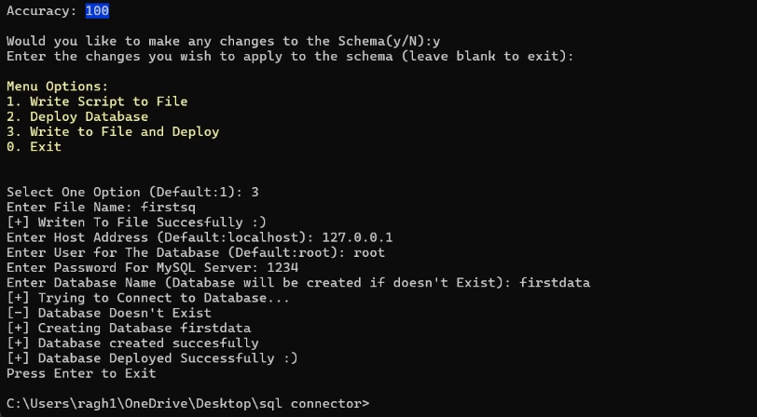
Schema Generation Output
The final step translates extracted features into SQL code.
Snap to SQL generates a fully functional SQL schema, ready for use in databases.
The generated schema reflects the relationships and attributes identified from the ER diagram.

Slide 6

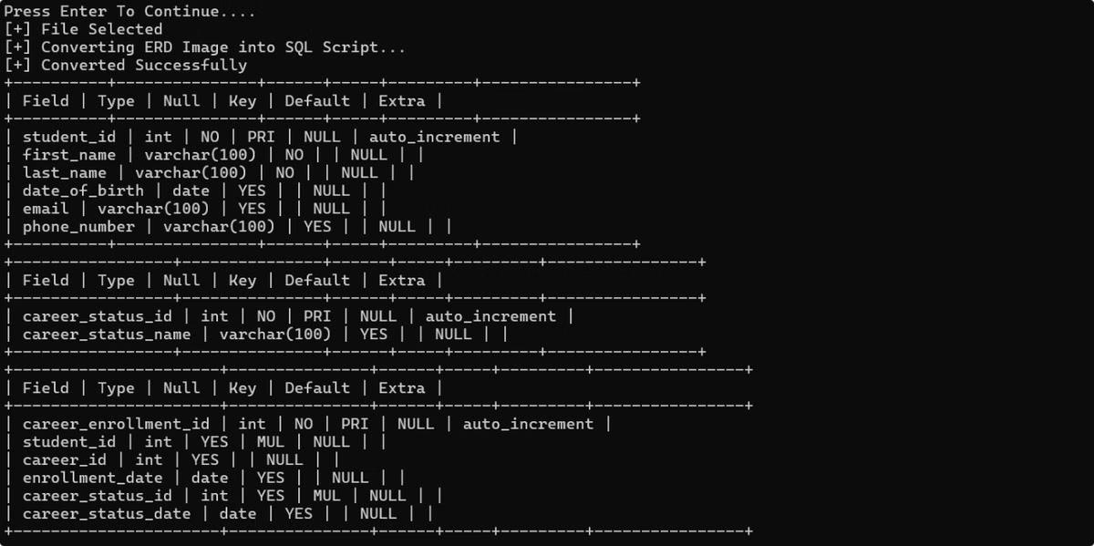
Schema Generation Output
The generated SQL schema accurately reflects the information captured from the ER diagram.
The output is presented in a user-friendly format, showcasing the tables, columns, data types, and relationships.

Slide 7
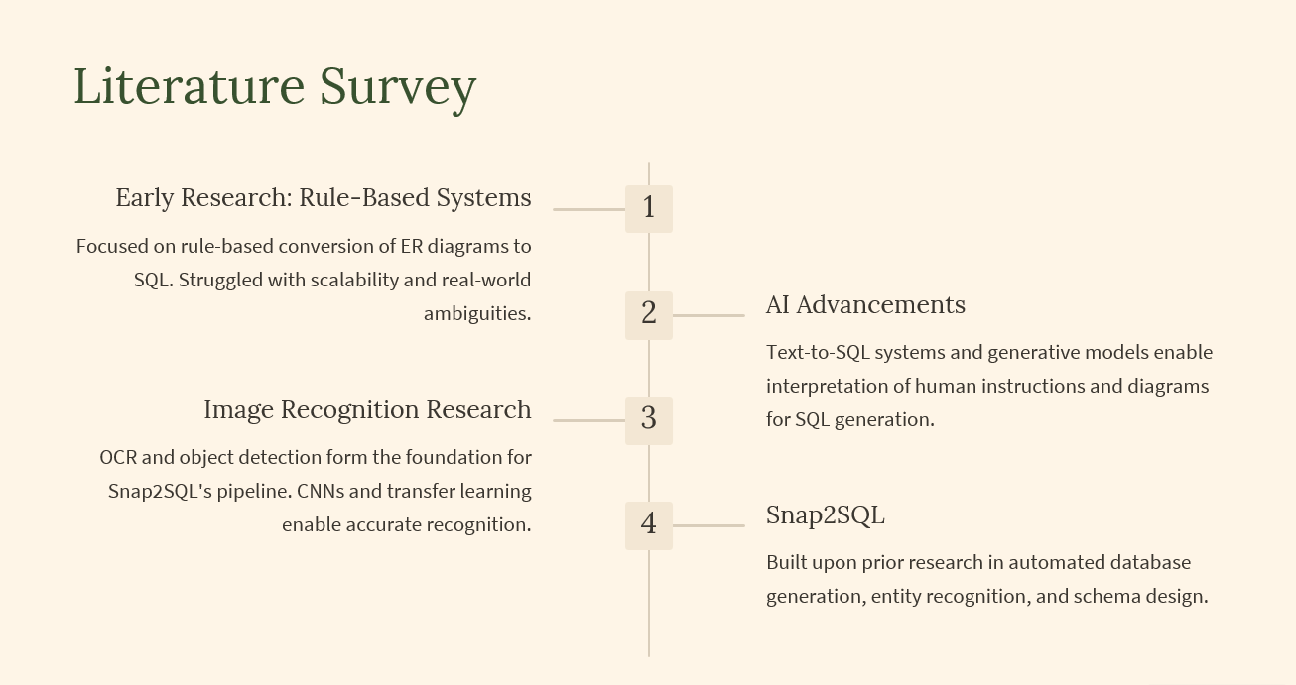
Literature Survey
Early Research: Rule-Based Systems
1
Focused on rule-based conversion of ER diagrams to SQL. Struggled with scalability and real-world ambiguities.
2
AI Advancements
Text-to-SQL systems and generative models enable interpretation of human instructions and diagrams for SQL generation.
Image Recognition Research
3
OCR and object detection form the foundation for Snap2SQL's pipeline. CNNs and transfer learning enable accurate recognition.
4
Snap2SQL
Built upon prior research in automated database generation, entity recognition, and schema design.

Slide 8

Conclusion and Future Directions
Snap to SQL revolutionizes database development.
1
Enhanced Accuracy
Improving the model's ability to handle complex diagrams.
2
Extended Functionality
Supporting additional database systems and features.
3
Integration with Development Tools
Seamlessly integrating with popular IDEs and platforms.

